Slide 1
Retail Dataset – Exploratory Data Analysis (EDA)
Next hikes It Solutions
Developed by : Vijendra Vaishnav

Slide 2
Introduction
What is EDA : Understanding data before modeling.
Importance : Detect pattern, anomalies, and insights.
Scope : Retail dataset with 100000 Rows and 18 Columns.

Slide 3
Subtitle
Univariate Analysis
Bivariate Analysis
Multivariate Analysis
Outliers
Correlation
Skewness
Kurtosis

Slide 4
Project overview
Exploratory data analysis (EDA) was performed on a retail transaction dataset.
The dataset contain 100000 Row and 18 Columns.
The analysis focus on customer behaviour, product pricing, discount , quantity, final transaction value and delivery performance.
Data type Numerical, Categorical, Date/Time.
Python, Pandas, Matplotlib and Seaborn used for analysis and visualization.

Slide 5
Project objective
Performed Univariate Analysis of numeric and categorical variables.
Performed Bivariate Analysis to identify relationship between variables.
Performed Multivariate Analysis involving three or more variables.
Detect and interpretation outliers.
Measure correlations between numeric variables.
Measure Skewness & Kurtosis for distribution shape.

Slide 6
Dataset overview
Dataset size :
        100000 Rows
        18 Columns
Variable type :
        Numerical, Categorical, Date.
Major areas:
        Customer information
        Product information
        Order information
        pricing and discount
        Payment
        Shipping and delivery
        Return status

Slide 7
Univariate Analysis
Univariate analysis examines one variable at a time
Numerical Analysis :
            Mean
            Mediam
            Standared
            Minimum
            Maximum
            Skewness
            Kurtosis
Example :
        Average Age : 41.56 year
        Average Product Price : 30164.53
        Average Quantity : 2.50
        Average Discount : 15.01%

Slide 8
Categorical Analysis
Categorical variables were analyzed using frequency counts and distributions.
Customer category
Customer segment
Shipping type
Purpose :
      Understand the composition of customers.
      Identify frequently occurring product categories.
      Compare customer segments.
      Understand payment and shipping preferences.

Slide 9
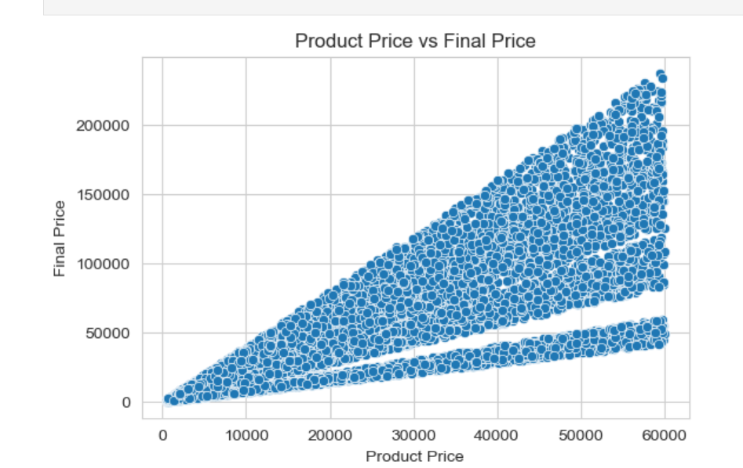
Bivariate Analysis
Bivariate analysis examines the relationship between two variables.
Product price Vs Final Price
Quantity And Final Price
Age and Spending
Delevery Day And Return Status
Segment vs Avg Price
Product Category vs Return Rate
Shipping Type vs Delivery Days
These comparisons help identify relationships and differences between important business variables.

Slide 10
Outlier Detection
The IQR (Interquartile Range) method was used.
Age
Product price
Quantity
Discount percentage
Final price
Delivery days
Result :
      Age : 0 outliers
      Product price : 0 outliers
      Quantity : 0 outliers
      Discount percentage : 0 outliers
      Final price : 503 potential outliers
      Delevery days : 0 outliers

Slide 11
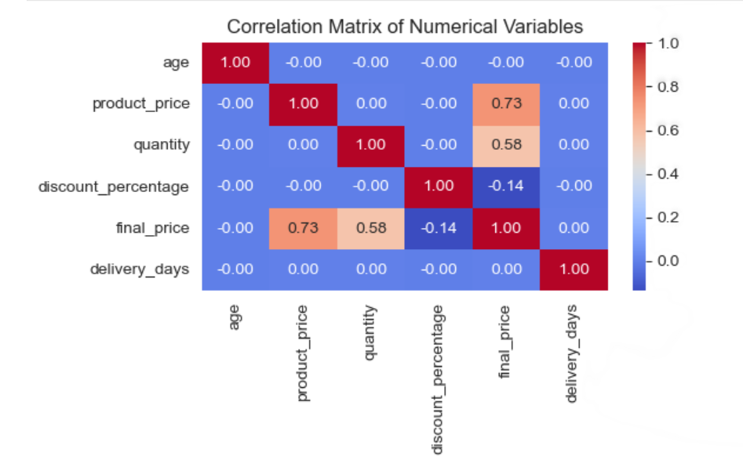
Correlation Analysis
A correlation matrix and heatmap were used to examine numerical relationships.
Variables:
    Age
    Product_price
    Quantity
    Discount_percentage
    Final price
    Delevery_days
Final_price is strongly related to pricing rrelated variable
Discount_percentage has a negative relationship with final_price.
Delevery days has relatively low relationships with spending related variables.

Slide 12
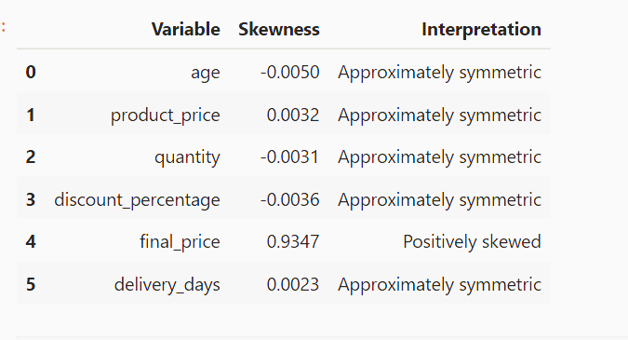
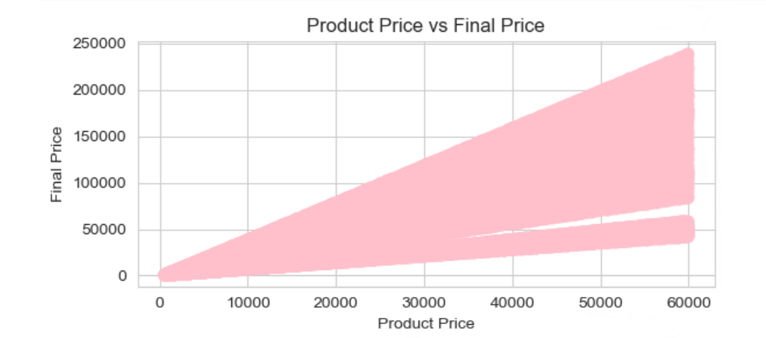
Skewness analysis

Slide 13
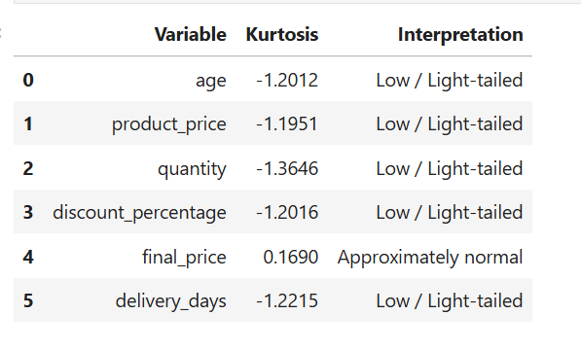
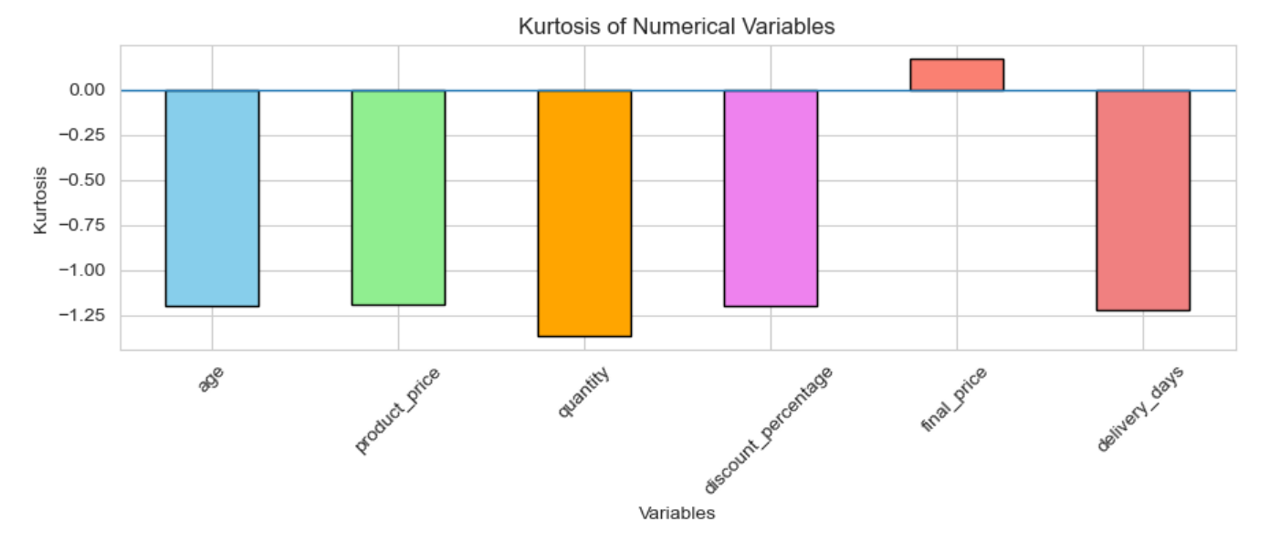
Kurtosis Analysis
Most variables have negative kurtosis.

Slide 14
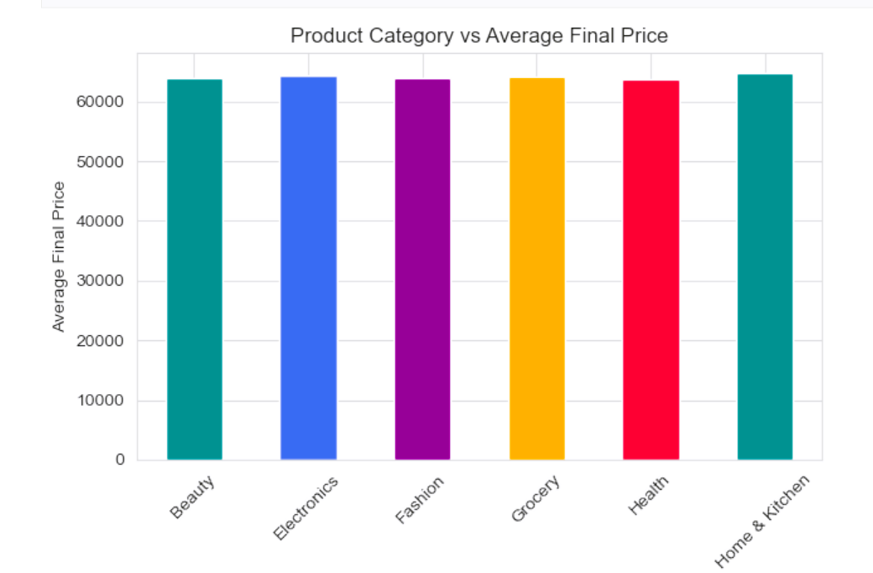
Multivariate Analysis
Multivariate analysis examines three or more variables together.
Product Category x Discount x Final Price
Customer Segment x Age x Spending
Delivery Days × Shipping Type × Return Status
Return related multivariate analysis excluded because return_status is null.

Slide 15
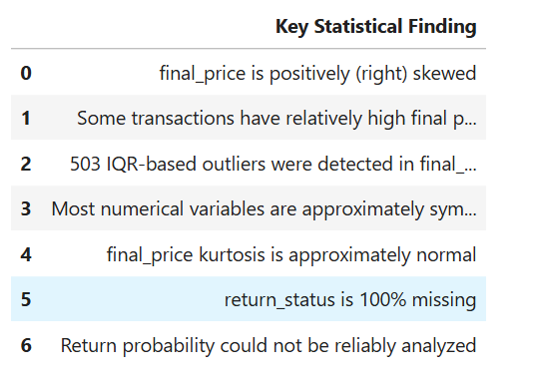
Key statical finding

Slide 16
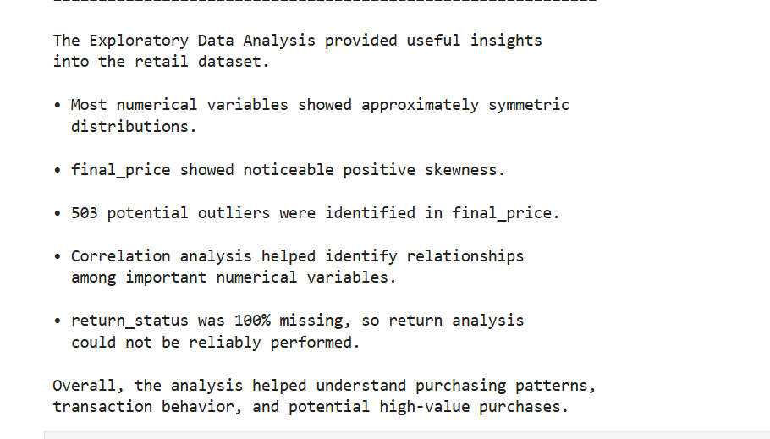
conclosion

Slide 17
Challenges
Missing Values
Outlier Detection
Data Visualization
Different Variable Scales
Interpreting Correlation
Large Dataset
Different Numerical Scales
Visualization Issues
Skewness Interpretation
Statistical Analysis ETC.
The project demonstrates how EDA and statistical techniques can be used to understand retail transaction data and support data-driven business analysis.

